Slide 1
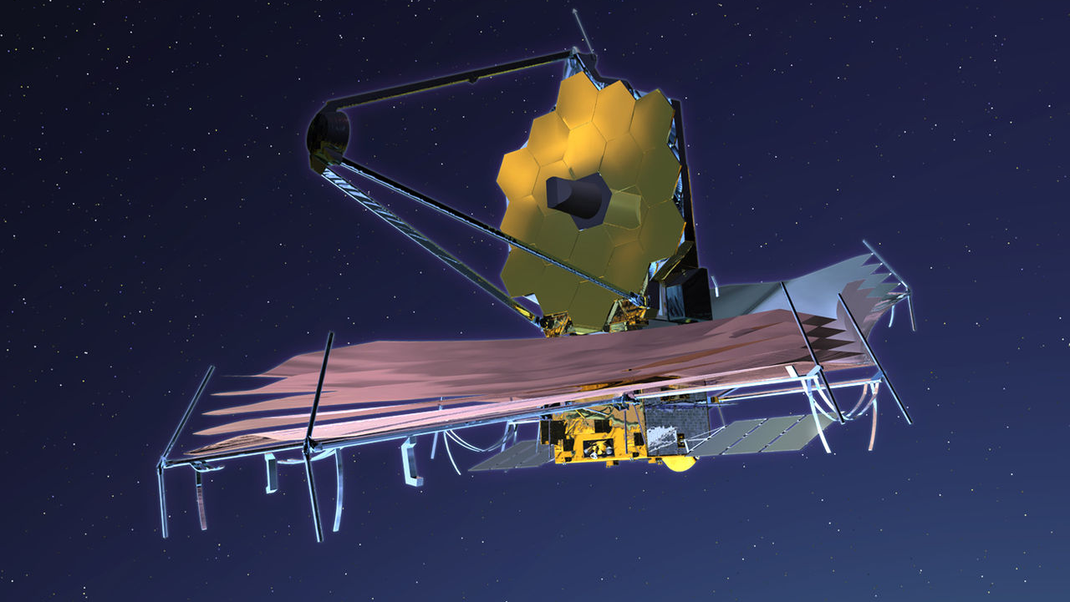
Simulating direct exoplanet detection with the James-Webb-Space Telescope
Semesterproject Niklas Viebig
"Dieses Foto" von Unbekannter Autor ist lizenziert gemäß CC BY-SA

Slide 2
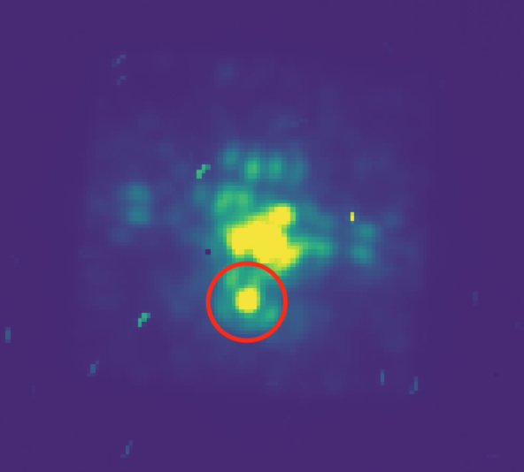
My goal in this project
Combine the coronagraphic simulator of the MIRI instrument with the detector simulator to create a full observational simulation
Notes:
Wrote a python code to combine the simulators PanCake and MIRIsim -> simulations of coronagraphic observations are possible

Slide 3
What are the applications?
Allows researchers to reevaluate observational strategies
Opportunity to better understand the equipment and its capabilities

Slide 4
Overview
Instrument
MIRI
Simulators
MIRIsim
PanCAKE
Results and Discussion
Coronagraphs

Slide 5
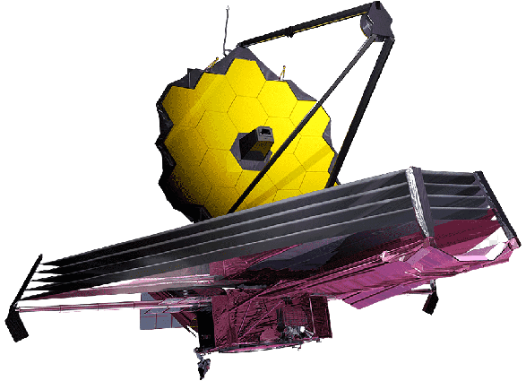
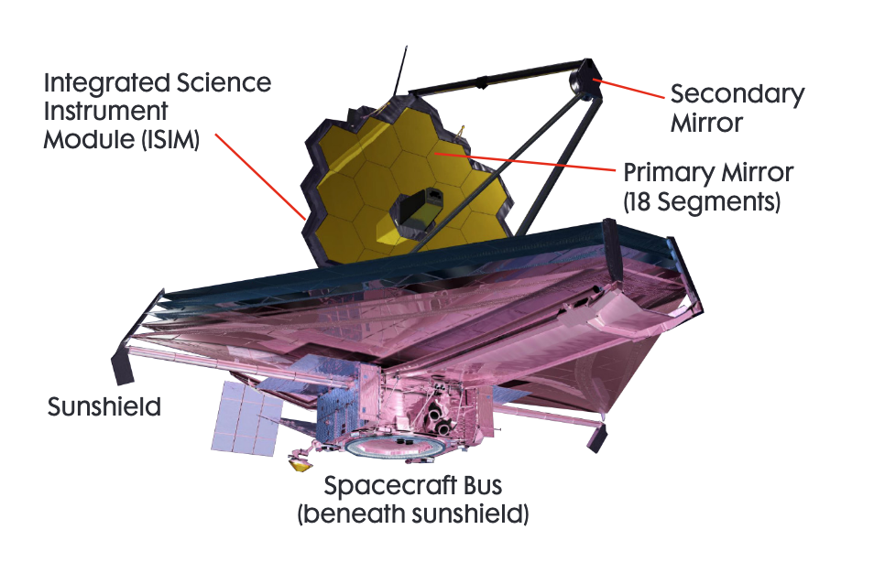
Instruments onboard JWST
the near-infrared camera (NIRCam), which covers the infrared wavelength range from 0.6 to 5 microns
the near-infrared Spectrograph (NIRSpec), which also covers a wavelength range from 0.6 to 5 microns
the near-infrared Imager and slitless Spectrograph (NIRISS), again covering the range from 0.6 to 5 microns
the Mid-Infrared Instrument (MIRI) covers the wavelength range from 5 to 28 microns.

Slide 6
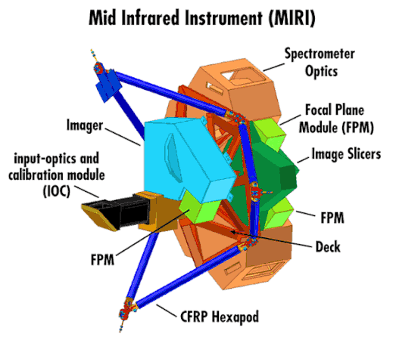
MIRI (Mid InfraRed Instrument)
One of the four instruments onboard JWST
Consists of an imager and a spectrometer
Can perform several observational modes
Imaging
Two types of coronagraphic imaging
Two types of spectroscopy

Slide 7
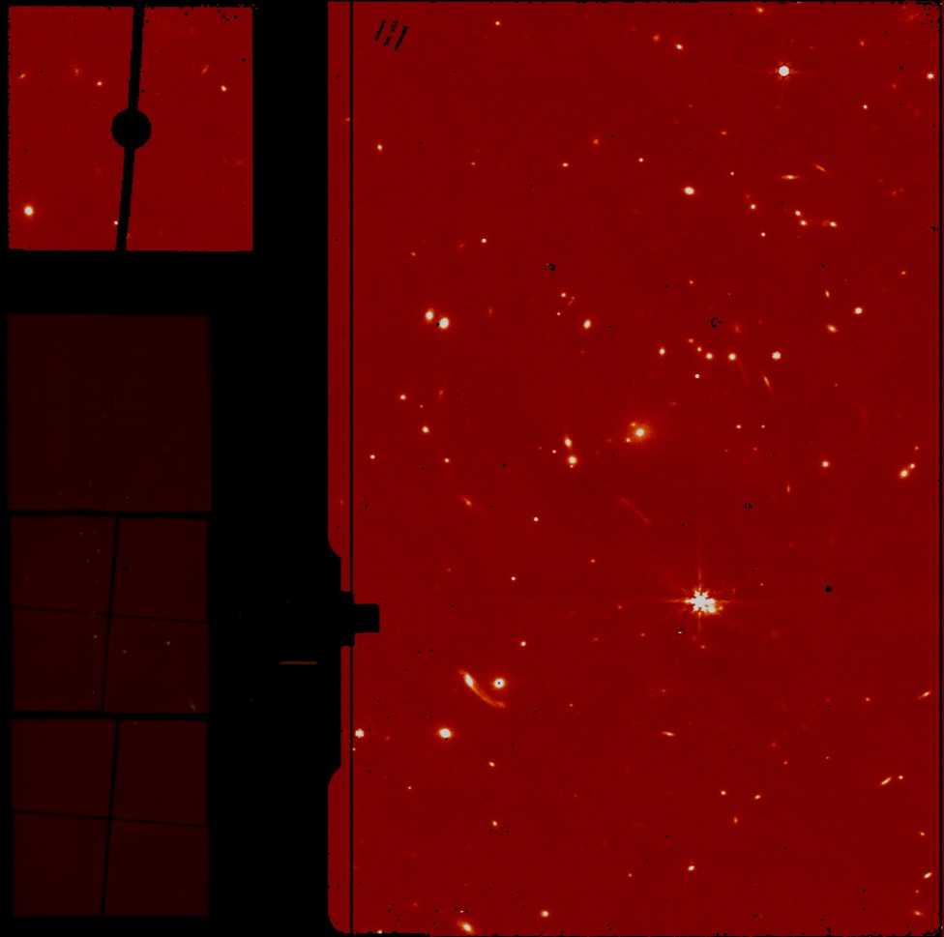
MIRI Imager

Slide 8
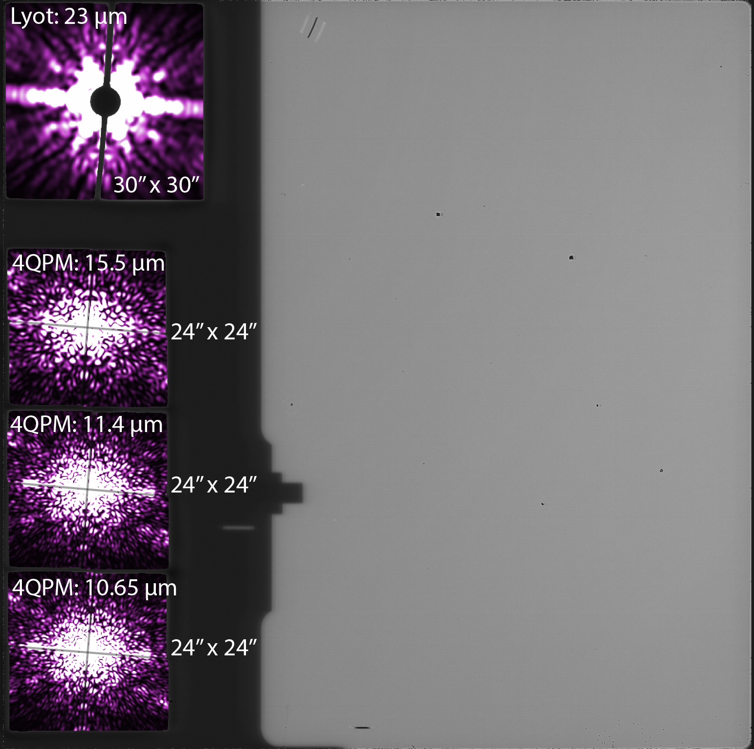
MIRI Coronagraphs
Two types of coronagraphs:
Lyot-Coronagraph
4QPM-Coronagraph

Slide 9
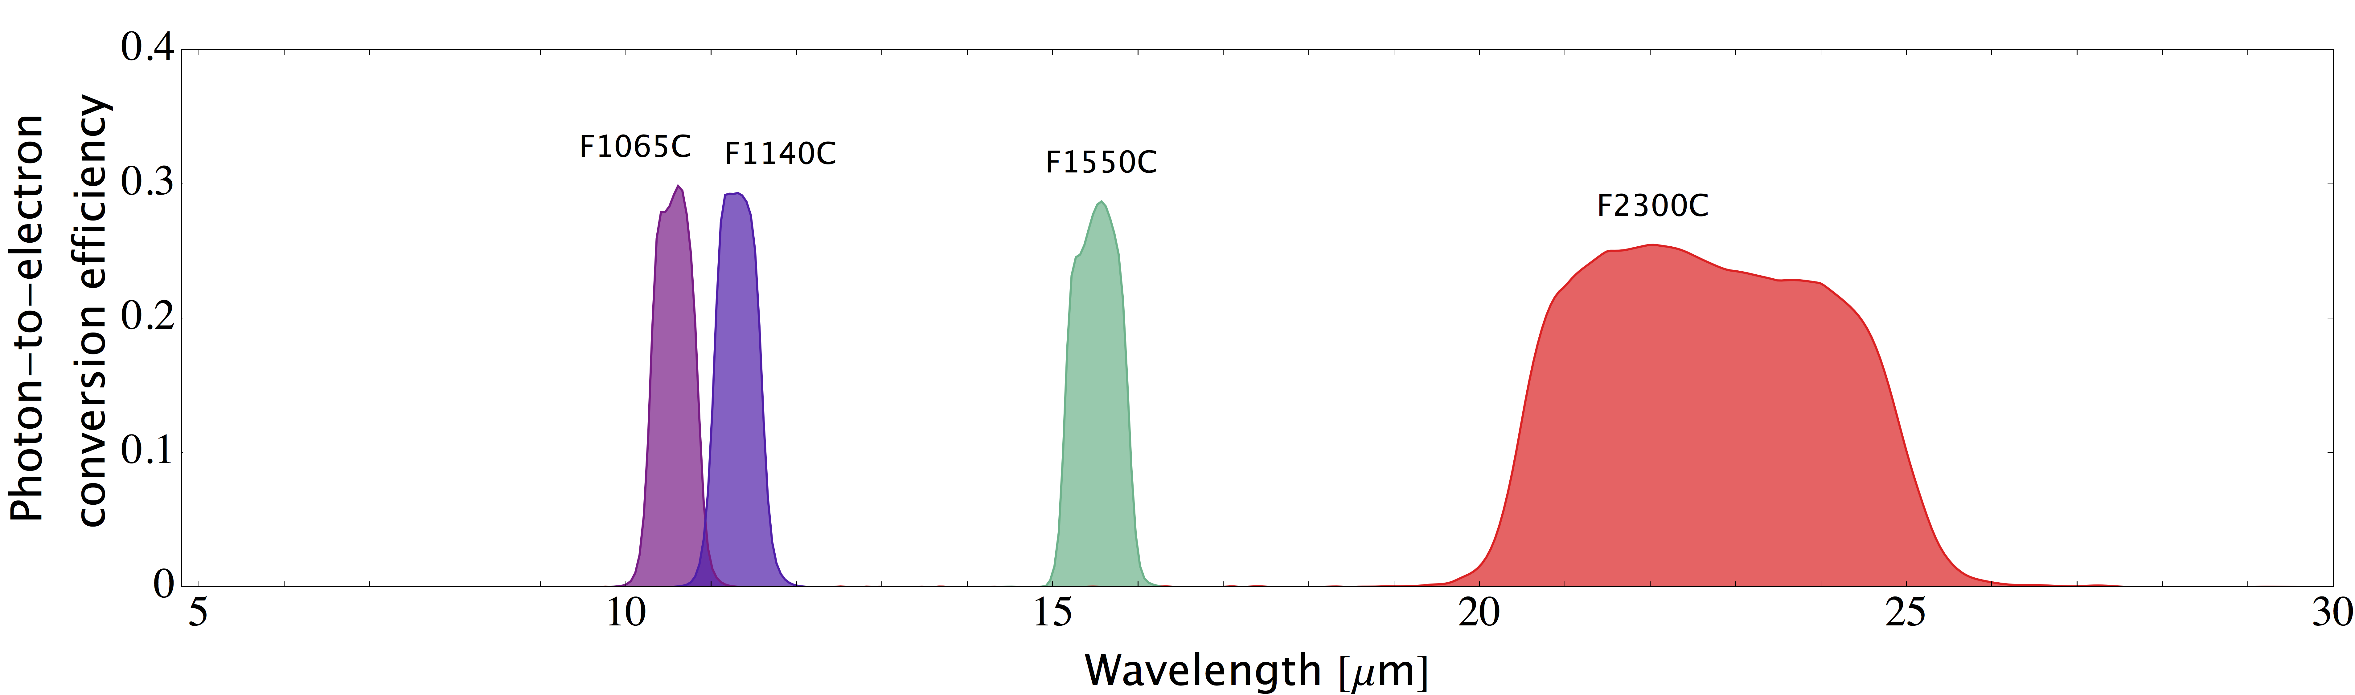
Coronagraphs

Slide 10

MIRIsim
Python Packages of the MIRI European Consortium
Can simulate both the imager and the spectrometer
Creates realistic data in the correct format
Calibration pipeline can be tested

Slide 11
How to use MIRIsim?
Simulation configuration
Takes in the simulation parameters
Scene configuration
Reads in the scene configuration

Slide 12
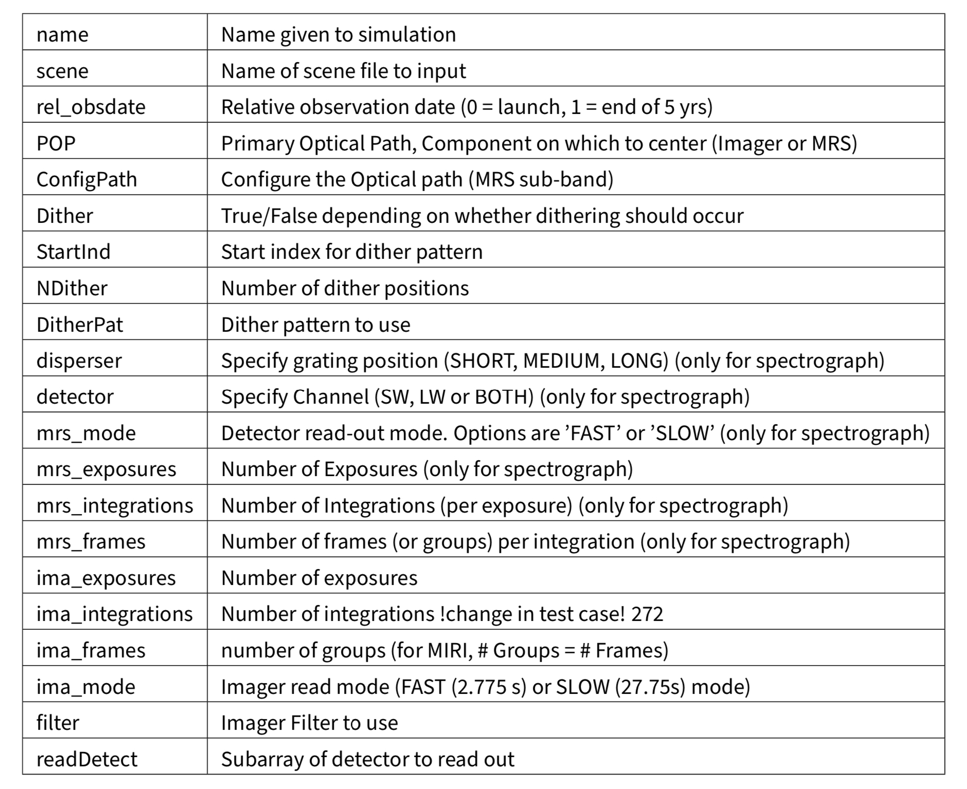

Slide 13
PanCAKE
PanCAKE: Coronagraphy Advanced Kit for Extractions
Improvement on Pandeia (ECT of the JWST)
In comparison to Pandeia, it can accurately simulate the coronagraphic performance

Slide 14
PanCAKE
Create a scene:
1
Add objects via stored files or directly from SIMBAD
Initialize observational sequence:
2
Takes a predetermined scene, exposure parameters (filter, number of groups...)
Run the simulation
3

Slide 15
Method
Create a Target scene with PanCAKE
01
Simulate the impact of the Coronagraph with PanCAKE
02
Store this scene
03
Modify the file, so that it can be handled by MIRIsim
04
Simulate the impact of the detector on the observation
05
Receive „realistic“ data which can be used further along the JWST pipline
06

Slide 16

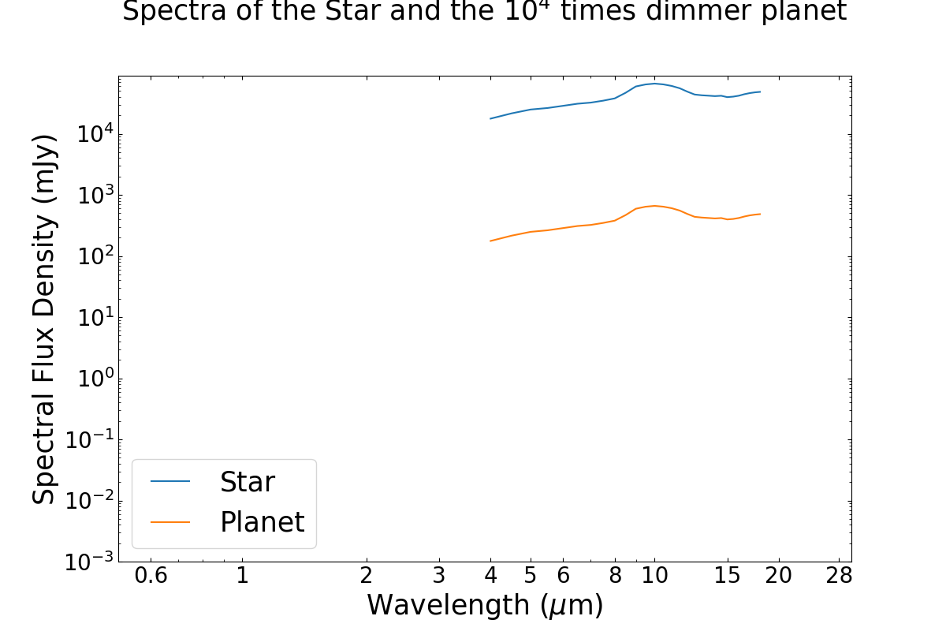
Results
Exoplanet, which is a thousand times dimmer than its star
Two arc seconds away from the star

Slide 17
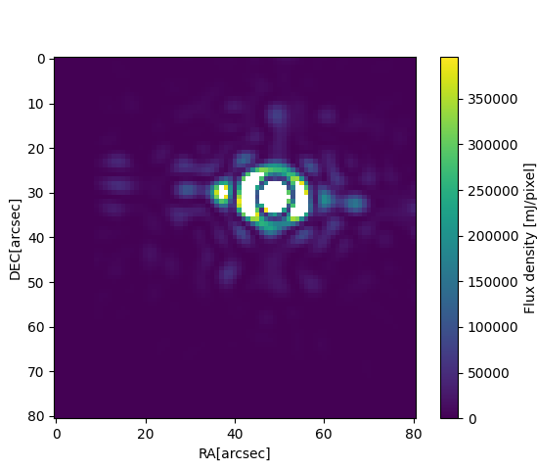
Results
The Figure shows the astronomical scene created with PanCAKE. Here, no coronagraph has been used. Therefore, the planet is hidden inside the stars diffraction pattern. This image is not centered, as it is an off-axis image. PanCAKE uses it to compute the contrast curve.

Slide 18
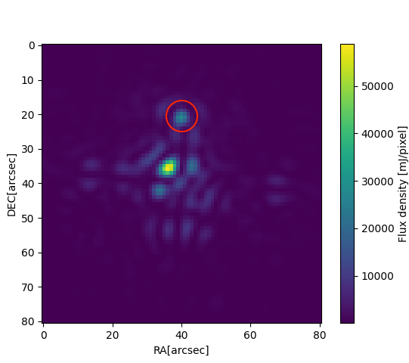
Results
Here, the coronagraph F 1140C has been used to observe the scene. It can be seen that the light of the sun has been mostly filtered out. This scene is before it is given over to MIRIsim. Therefore, the MIRIs influence on the result has not been taken into account

Slide 19
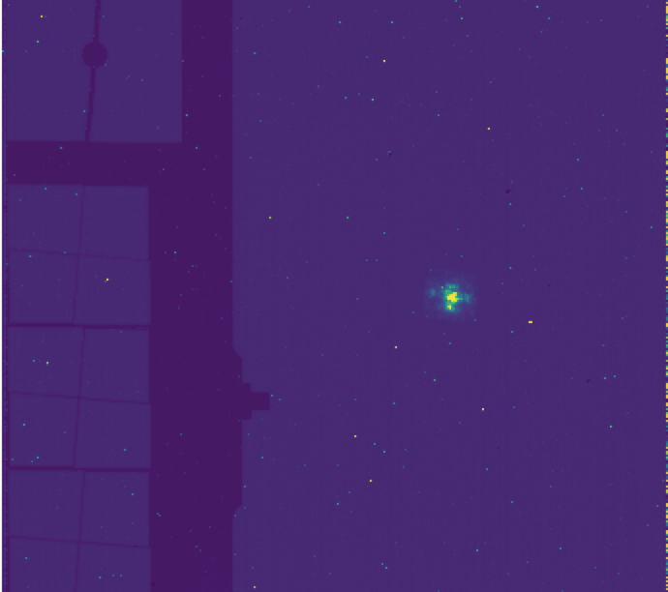
Results
The finished MIRIsim simulation. Here, one can clearly see the outlines of the imager and the four corona- graphs.

Slide 20
Results
The stellar environment

Slide 21
Discussion
Lack of resources
Does not support:
extended emission objects like circumstellar disks
Roll angles
Glowstick effect
Computationally heavy

Slide 22
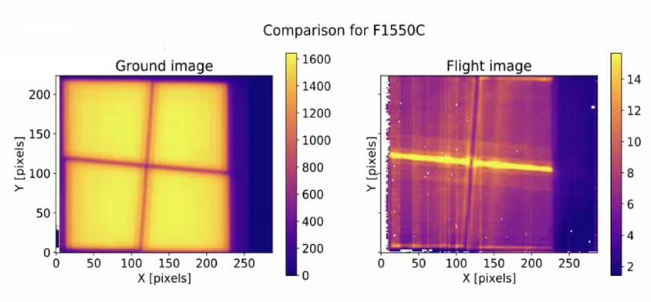
Glowstick effect

Slide 23
Semesterproject Niklas Viebig
"Dieses Foto" von Unbekannter Autor ist lizenziert gemäß CC BY-SA

Slide 24
